Slide 1
Biological Modeling of Neural Networks
Week 4: Reducing Detail – 2D models-Adding Detail
3.1 From Hodgkin-Huxley to 2D
3.2 Phase Plane Analysis
3.3 Analysis of a 2D Neuron Model
4.1 Type I and II Neuron Models
- limit cycles
- where is the firing threshold?
- separation of time scales
4.2. Adding Detail
- synapses
-dendrites
- cable equation
Week 4
– Reducing detail
- Adding detail
Wulfram Gerstner
EPFL, Lausanne, Switzerland

Slide 2
Neuronal Dynamics – Review from week 3
Reduction of Hodgkin-Huxley to 2 dimension
-step 1: separation of time scales
-step 2: exploit similarities/correlations

Slide 3
Neuronal Dynamics – 4.1. Reduction of Hodgkin-Huxley model
1) dynamics of m are fast
2) dynamics of h and n are similar
w(t)
w(t)

Slide 4
Neuronal Dynamics – 4.1. Analysis of a 2D neuron model
2-dimensional equation
stimulus
w
I(t)=I₀
Enables graphical analysis!
u
Pulse input
→ AP firing (or not)
Constant input
→ repetitive firing (or not)
→ limit cycle (or not)

Slide 5
Week 4 – part 1: Reducing Detail – 2D models
ramp input/
constant input
3.1 From Hodgkin-Huxley to 2D
3.2 Phase Plane Analysis
3.3 Analysis of a 2D Neuron Model
4.1 Type I and II Neuron Models
- limit cycles
- where is the firing threshold?
- separation of time scales
4.2. Dendrites
neuron
I0
Type I and type II models
f-I curve
f-I curve
f
I0
I0

Slide 6
Neuronal Dynamics – 4.1. Type I and II Neuron Models
neuron
ramp input/
constant input
I0
Type I and type II models
f-I curve
f-I curve
f
I0
I0

Slide 7
2 dimensional Neuron Models
stimulus
w
w-nullcline
I(t)=I₀
apply constant stimulus I0
u
u-nullcline

Slide 8
FitzHugh Nagumo Model – limit cycle
stimulus
w
I(t)=I₀
-unstable fixed point
-closed boundary
with arrows pointing inside
u
limit cycle
limit cycle

Slide 9
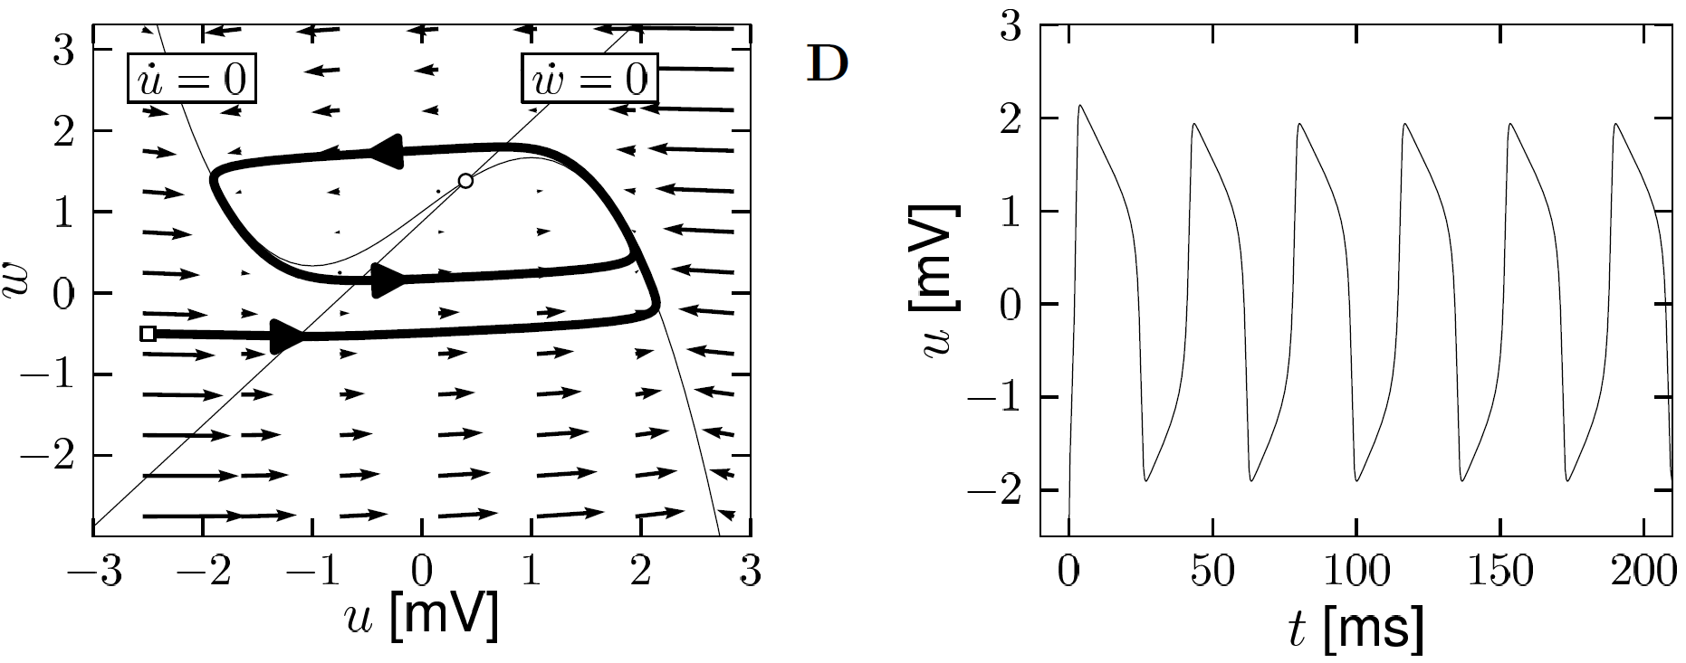
Neuronal Dynamics – 4.1. Limit Cycle
-unstable fixed point in 2D
-bounding box with inward flow
→ limit cycle (Poincare Bendixson)
Image: Neuronal Dynamics,
Gerstner et al.,
Cambridge Univ. Press (2014)

Slide 10
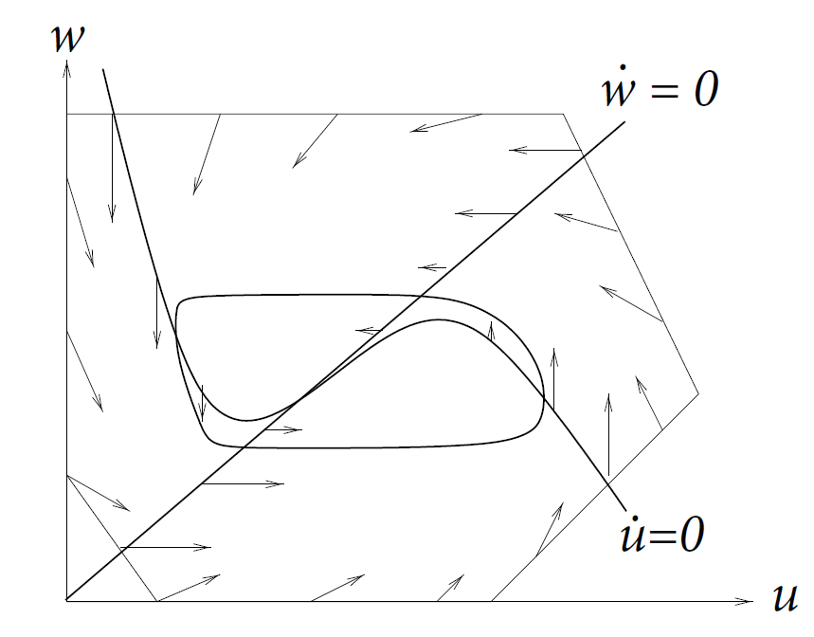
Neuronal Dynamics – 4.1. Limit Cycle
In 2-dimensional equations,
a limit cycle must exist, if we can
find a surface
-containing one unstable fixed point
-no other fixed point
-bounding box with inward flow
→ limit cycle (Poincare Bendixson)
Image: Neuronal Dynamics,
Gerstner et al.,
Cambridge Univ. Press (2014)

Slide 11
Type II Model
constant input
stimulus
w
Hopf bifurcation
I(t)=I₀
u
Discontinuous gain function
I₀
Stability lost → oscillation with finite frequency

Slide 12
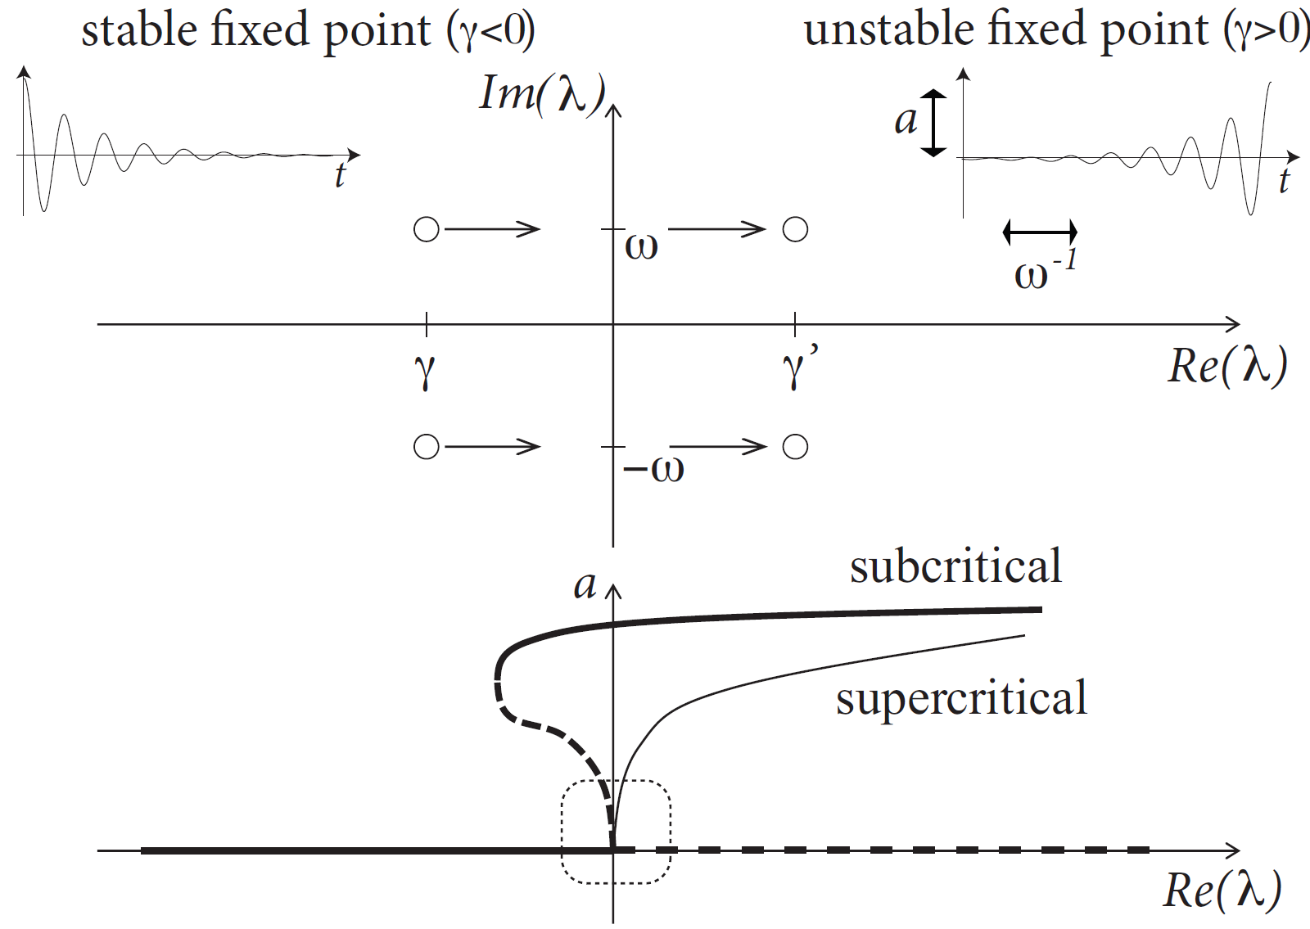
Neuronal Dynamics – 4.1. Hopf bifurcation

Slide 13
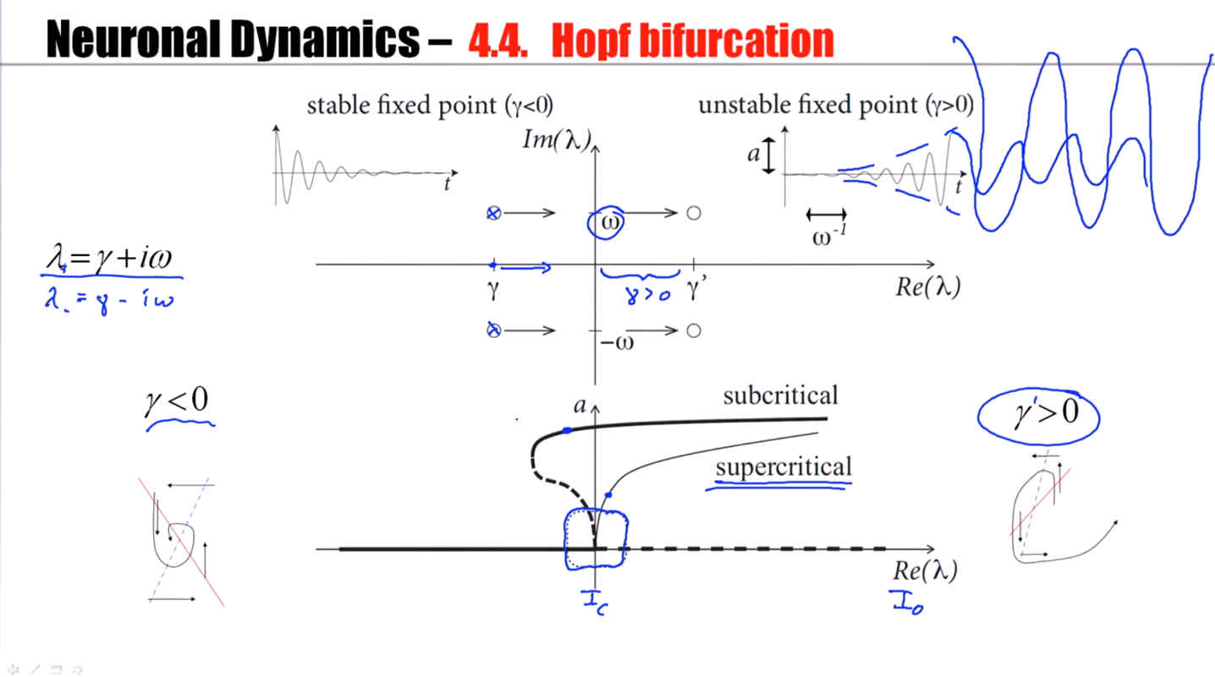

Slide 14
Neuronal Dynamics – 4.1. Hopf bifurcation: f-I -curve
f-I curve
Discontinuous
gain function: Type II
ramp input/
constant input
I0
I₀
Stability lost → oscillation with finite frequency

Slide 15
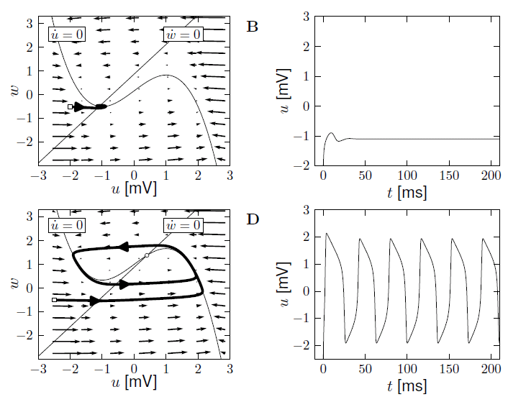
FitzHugh-Nagumo: type II Model – Hopf bifurcation
I=0
I>Ic

Slide 16
Neuronal Dynamics – 4.1, Type I and II Neuron Models
neuron
ramp input/
constant input
I0
Now:
Type I model
Type I and type II models
f-I curve
f-I curve
f
I0
I0
Notes:
刚刚说的都是type 2 模型，也就是电流在一定情况下，是不会频率的（也就是没有周期活动）

Slide 17
Neuronal Dynamics – 4.1. Type I and II Neuron Models
type I Model: 3 fixed points
stimulus
size of arrows!
w
apply constant stimulus I0
I(t)=I₀
u
Saddle-node bifurcation
unstable
saddle
stable

Slide 18
Saddle-node bifurcation
stimulus
w
Blackboard:
- flow arrows,
- ghost/ruins
I(t)=I₀
u
unstable
saddle
stable
Notes:
A constant stimulus will shift the curve upwards. It might be a slight change in the shape of the nullcline.
But, essentially, it's a shift upwards.
And if you shift a nullcline upwards, what we see is that these fixed points, they disappear.

Slide 19
type I Model – constant input
stimulus
w
I(t)=I₀
u
Low-frequency firing
I₀
Notes:
由于fix point没有了，所以也就没有吸引子了，就一定会有一个周期活动。因为fix point上移，但它还在吸引，因此周期活动很慢。

Slide 20
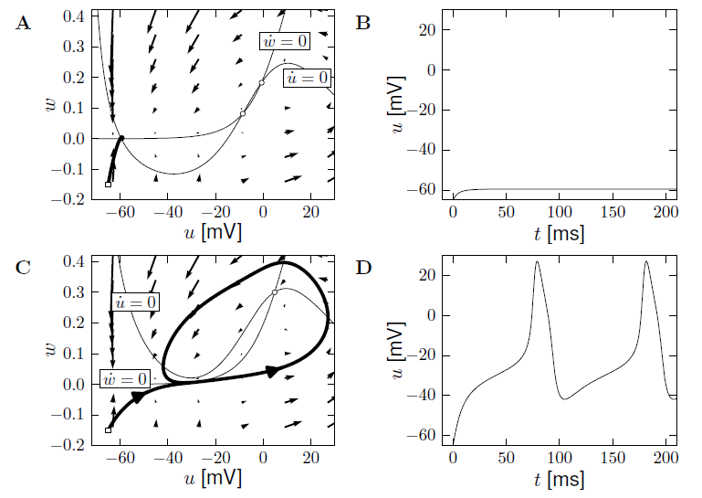
Morris-Lecar, type I Model – constant input
I=0
I>Ic

Slide 21
type I Model – Morris-Lecar: constant input
stimulus
w
I(t)=I₀
u
Low-frequency firing
I₀

Slide 22
Type I and type II models
Response at firing threshold?
Type I type II
Saddle-Node
Onto limit cycle
For example:
Subcritical Hopf
ramp input/
constant input
f-I curve
f-I curve
f
f
I0
I0
I0

Slide 23
Neuronal Dynamics – 4.1. Type I and II Neuron Models
neuron
ramp input/
constant input
I0
Type I and type II models
f-I curve
f-I curve
f
I0
I0
Notes:
To summarize, biologists have made a distinction between type 1 neurons, those that have a continuous gain function, those that are able to fire at very low frequency on one side, and type 2 neurons, those that have a minimal firing frequency and which a discontinuous gain function.

Slide 24
Neuronal Dynamics – Quiz 4.1.
2-dimensional neuron model with (supercritical) saddle-node-onto-limit cycle bifurcation
[ ] The neuron model is of type II, because there is a jump in the f-I curve
[ ] The neuron model is of type I, because the f-I curve is continuous
[ ] The neuron model is of type I, if the limit cycle passes through a regime where the flow is very slow.
[ ] in the regime below the saddle-node-onto-limit cycle bifurcation, the neuron is
at rest or will converge to the resting state.
B. Threshold in a 2-dimensional neuron model with subcritical Hopf bifurcation
[ ] The neuron model is of type II, because there is a jump in the f-I curve
[ ] The neuron model is of type I, because the f-I curve is continuous
[ ] in the regime below the Hopf bifurcation, the neuron is
at rest or will necessarily converge to the resting state
Notes:
Ich war hier nach 40 Minuten

Slide 25
Biological Modeling of Neural Networks
Week 4 – part 1: Reducing Detail – 2D models
3.1 From Hodgkin-Huxley to 2D
3.2 Phase Plane Analysis
3.3 Analysis of a 2D Neuron Model
4.1 Type I and II Neuron Models
- limit cycles
- where is the firing threshold?
- separation of time scales
4.2. Adding detail
Week 4
– Reducing detail
- Adding detail
Wulfram Gerstner
EPFL, Lausanne, Switzerland

Slide 26
Neuronal Dynamics – 4.1. Threshold in 2dim. Neuron Models
neuron
pulse input
I(t)
Delayed spike
u
Reduced amplitude
u
Notes:
If the two fixed points have disappeared, a limit cycle emerges around the remaining unstable fixed point.
This limit cycle has a part where the trajectory moves incredibly slowly.
The reason is that it moves through the region where, just before the bifurcation, there have been fixed points. The flow at the fixed point is, by definition, zero.

Slide 27
Neuronal Dynamics – 4.1 Bifurcations, simplifications
Bifurcations in neural modeling,
Type I/II neuron models,
Canonical simplified models
Nancy Koppell,
Bart Ermentrout,
John Rinzel,
Eugene Izhikevich
and many others

Slide 28
Review: Saddle-node onto limit cycle bifurcation
stimulus
w
I(t)=I₀
u
unstable
saddle
stable

Slide 29
Neuronal Dynamics – 4.1 Pulse input
stimulus
w
pulse input
I(t)
I(t)=I₀
u
unstable
saddle
stable

Slide 30
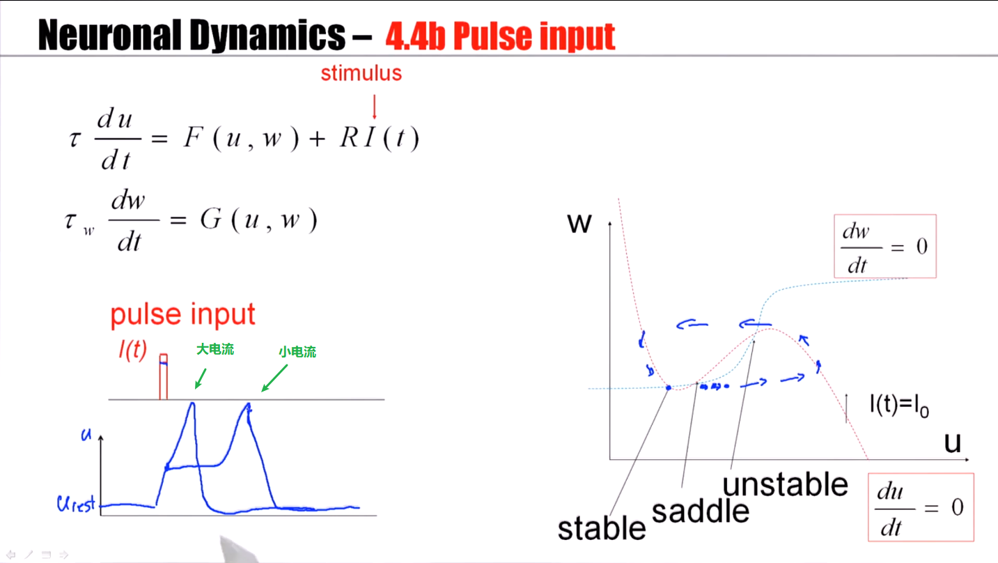
Notes:
小电流在鞍点会变慢，但最终通过还是会firing

Slide 31
4.1 Type I model: Pulse input
saddle
stimulus
w
pulse input
Slow!
u
I(t)
blackboard
Threshold
for pulse input

Slide 32
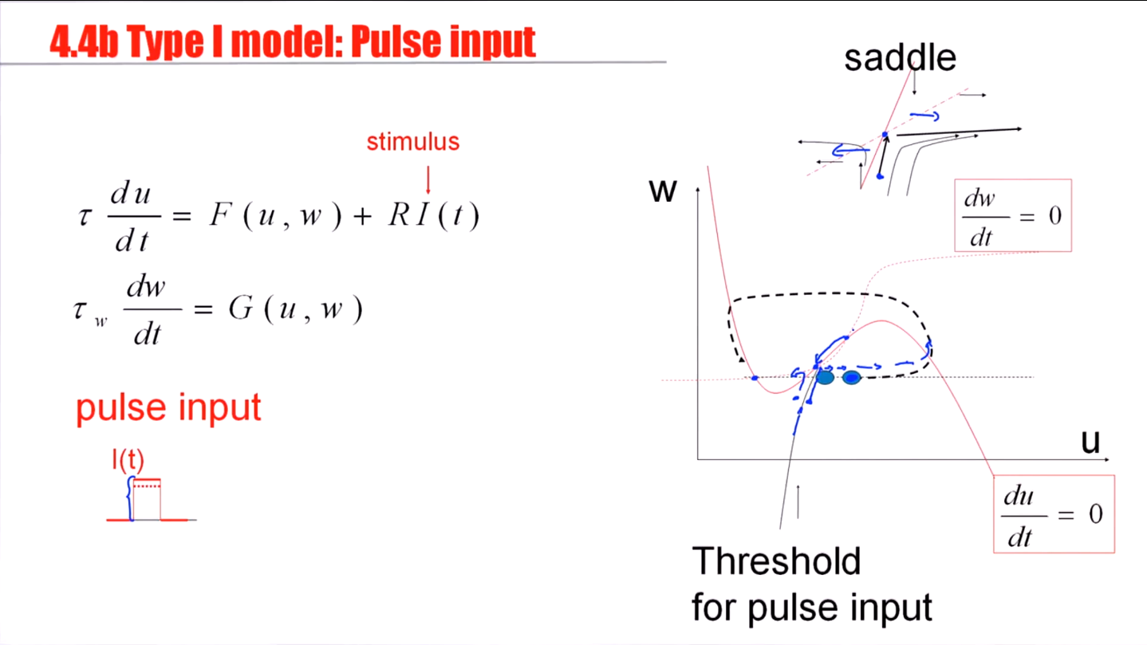
Notes:
There's one unique trajectory. A saddle point is characterized by one unique trajectory.
There's only one trajectory from below that will really approach the saddle and stay at the saddle. All other trajectories will either bend to the left or to the right.
This attractive manifold of the saddle, the stable manifold, will serve as a threshold for pulse input.

Slide 33
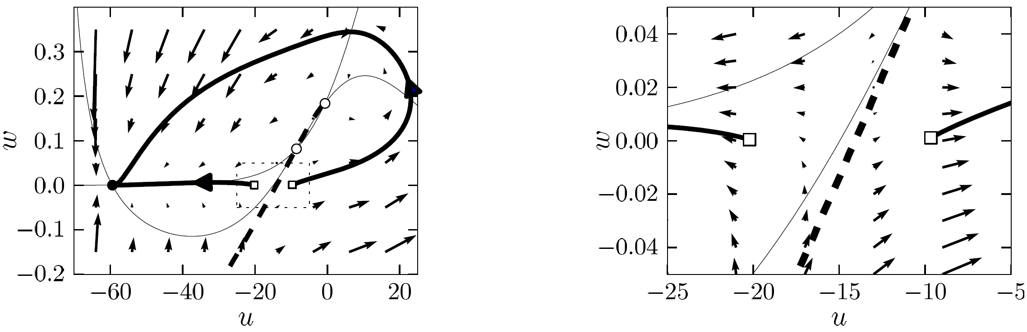
4.1 Type I model: Threshold for Pulse input
Stable manifold plays role of
‘Threshold’ (for pulse input)
Image: Neuronal Dynamics,
Gerstner et al.,
Cambridge Univ. Press (2014)

Slide 34
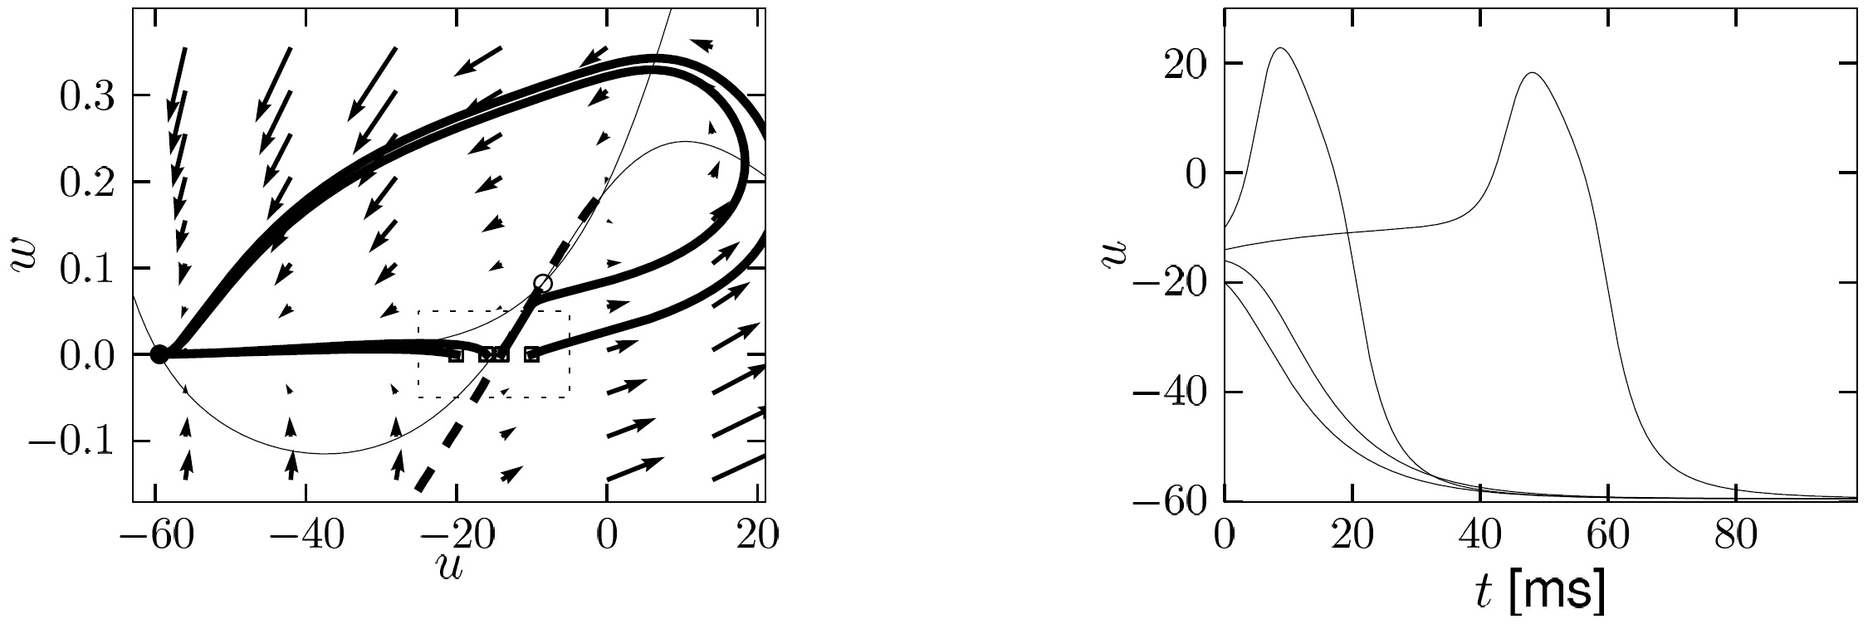
4.1 Type I model: Delayed spike initation for Pulse input
Delayed spike initiation close to
‘Threshold’ (for pulse input)
Image: Neuronal Dynamics,
Gerstner et al.,
Cambridge Univ. Press (2014)

Slide 35
Neuronal Dynamics – 4.1 Threshold in 2dim. Neuron Models
neuron
pulse input
I(t)
Delayed spike
Reduced amplitude
u
u
NOW: model with subc. Hopf

Slide 36
Review: FitzHugh-Nagumo Model: Hopf bifurcation
stimulus
w
w-nullcline
I(t)=I₀
apply constant stimulus I0
u
u-nullcline

Slide 37
FitzHugh-Nagumo Model - pulse input
stimulus
w
No explicit
threshold
for pulse input
pulse input
I(t)
u
Stable fixed point
I(t)=0

Slide 38
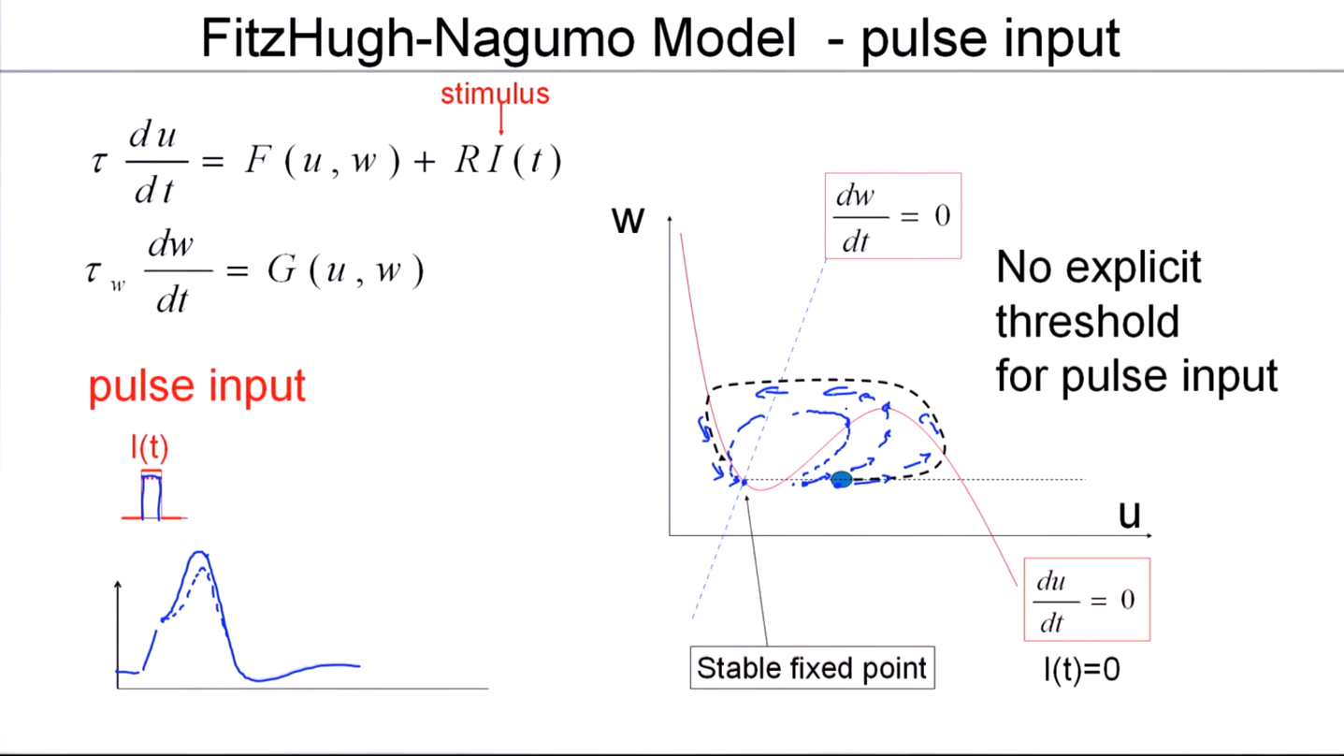
Notes:
In this kind of model, with a Hopf bifurcation in the regime where wehave a stable fixed point there's no such thing as a strict threshold. There's no stable manifold that could serve as a threshold.

Slide 39
FitzHugh-Nagumo Model - pulse input threshold?
stimulus
w
Separation of time scales
pulse input
I(t)=0
I(t)
u
blackboard
Stable fixed point

Slide 40
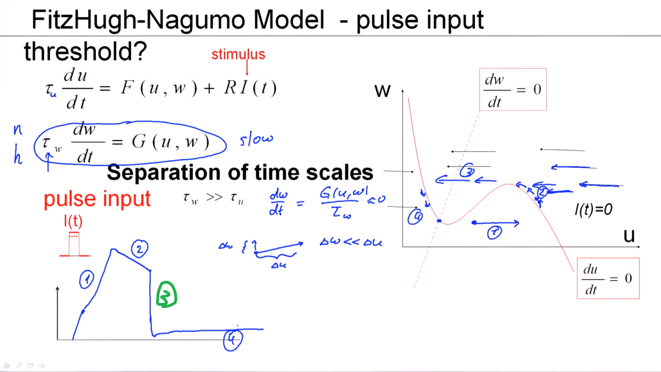
Notes:
因为tau_w远大于tau_u，所以w的变化值远小于u。
在除了u-nullcline的所有地方，所有变化都是横的，只有在u-nullcline，变化才是竖的。

Slide 41
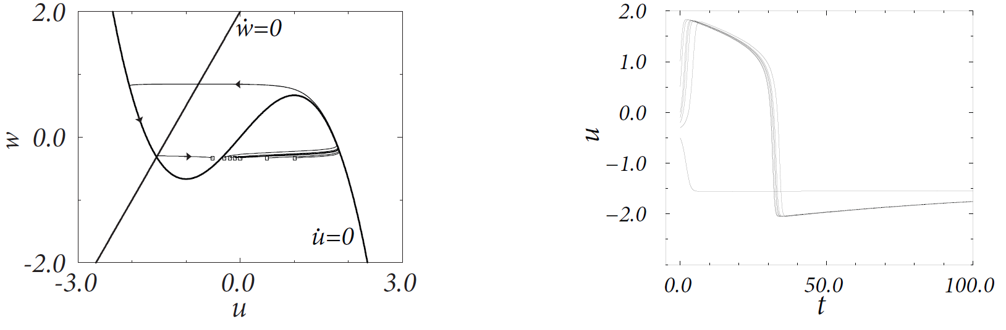
4.1 FitzHugh-Nagumo model: Threshold for Pulse input
Assumption:
Middle branch of u-nullcline
plays role of
‘Threshold’ (for pulse input)
Image: Neuronal Dynamics,
Gerstner et al.,
Cambridge Univ. Press (2014)

Slide 42
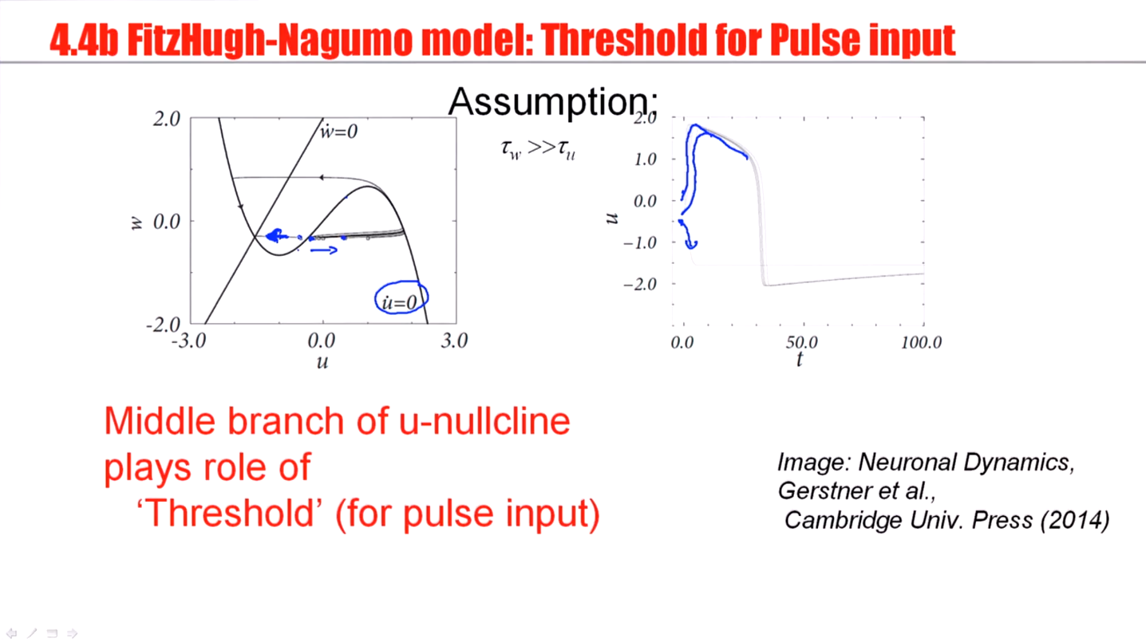
Notes:
The middle branch of the u-nullcline acts effectively as a threshold for spike initiation on the pulse input.
在这种情况下，是有threshold的！

Slide 43
Biological Modeling of Neural Networks
Week 4 – part 1: Reducing Detail – 2D models
3.1 From Hodgkin-Huxley to 2D
3.2 Phase Plane Analysis
3.3 Analysis of a 2D Neuron Model
4.1 Type I and II Neuron Models
- limit cycles
- where is the firing threshold?
- separation of time scales
4.2. Dendrites
Week 4
– Reducing detail
- Adding detail
Wulfram Gerstner
EPFL, Lausanne, Switzerland

Slide 44
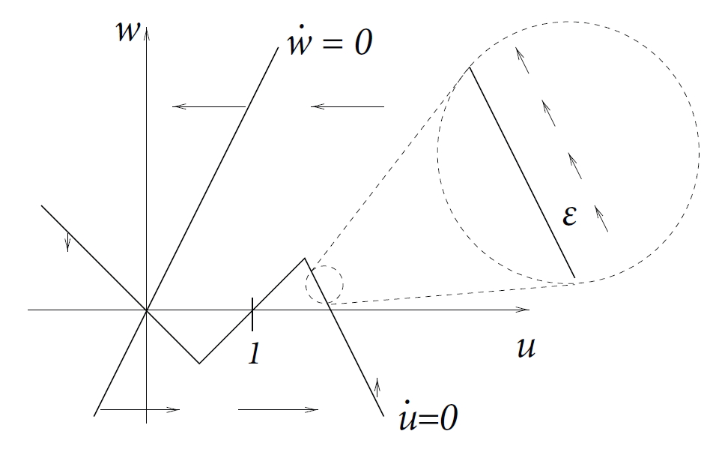
4.1 Detour: Separation fo time scales in 2dim models
stimulus
Assumption:
Image: Neuronal Dynamics,
Gerstner et al.,
Cambridge Univ. Press (2014)

Slide 45
4.1 FitzHugh-Nagumo model: Threshold for Pulse input
Assumption:
slow
fast
slow
slow
fast
slow
trajectory
-follows u-nullcline:
-jumps between branches:
slow
Image: Neuronal Dynamics,
Gerstner et al.,
Cambridge Univ. Press (2014)
fast

Slide 46
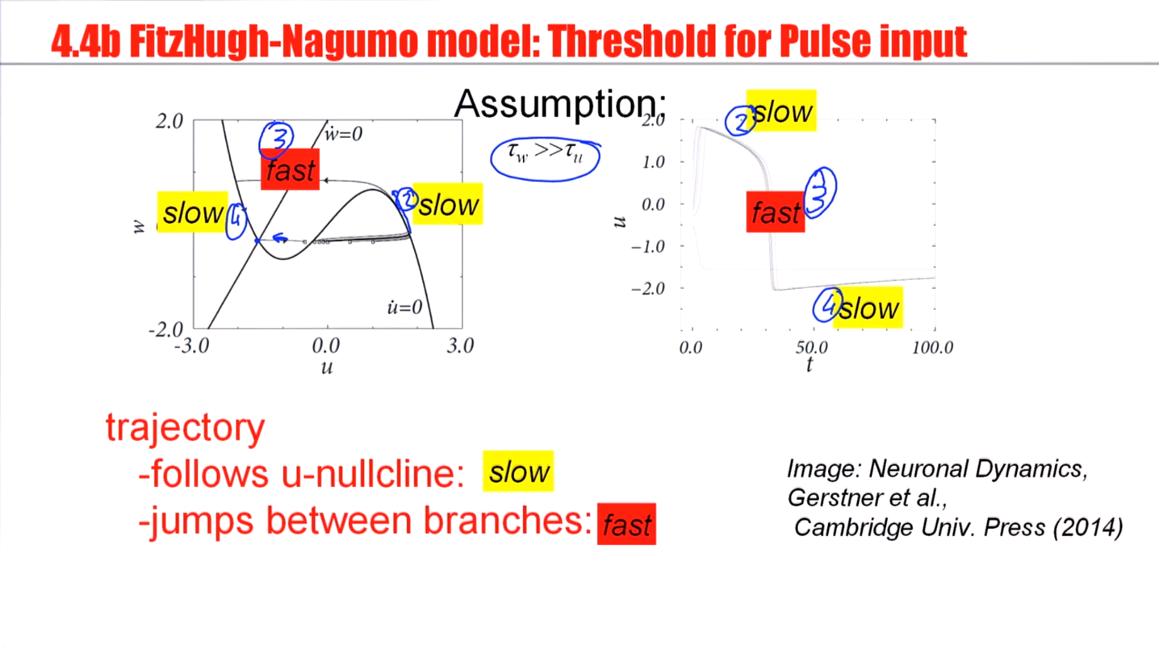

Slide 47
Neuronal Dynamics – 4.1 Threshold in 2dim. Neuron Models
neuron
pulse input
I(t)
Biological input scenario
Mathematical explanation:
Graphical analysis in 2D
Delayed spike
Reduced amplitude
u
u

Slide 48
Exercise 1: NOW!
inhibitory rebound
Assume separation
of time scales
w
I(t)=0
Stable fixed
point at -I0
u
I(t)=I₀<0
0
Next lecture:
10:55
-I0
I(t)
Notes:
Ich war hier um 10:40, dann 15 minuten fuer exercises.

Slide 49
Neuronal Dynamics – Literature for week 3 and 4.1
Reading: W. Gerstner, W.M. Kistler, R. Naud and L. Paninski,
Neuronal Dynamics: from single neurons to networks and
models of cognition. Chapter 4: Introduction. Cambridge Univ. Press, 2014
OR W. Gerstner and W.M. Kistler, Spiking Neuron Models, Ch.3. Cambridge 2002
OR J. Rinzel and G.B. Ermentrout, (1989). Analysis of neuronal excitability and oscillations. In Koch, C. Segev, I., editors, Methods in neuronal modeling. MIT Press, Cambridge, MA.
Selected references.
-Ermentrout, G. B. (1996). Type I membranes, phase resetting curves, and synchrony.
Neural Computation, 8(5):979-1001.
Fourcaud-Trocme, N., Hansel, D., van Vreeswijk, C., and Brunel, N. (2003). How spike generation mechanisms determine the neuronal response to fluctuating input.
J. Neuroscience, 23:11628-11640.
Badel, L., Lefort, S., Berger, T., Petersen, C., Gerstner, W., and Richardson, M. (2008). Biological Cybernetics, 99(4-5):361-370.
- E.M. Izhikevich, Dynamical Systems in Neuroscience, MIT Press (2007)

Slide 50
Neuronal Dynamics – Quiz 4.2.
Threshold in a 2-dimensional neuron model with saddle-node bifurcation
[ ] The voltage threshold for repetitive firing is always the same
as the voltage threshold for pulse input.
[ ] in the regime below the saddle-node bifurcation, the voltage threshold for repetitive firing is given by the stable manifold of the saddle.
[ ] in the regime below the saddle-node bifurcation, the voltage threshold for repetitive firing is given by the middle branch of the u-nullcline.
[ ] in the regime below the saddle-node bifurcation, the voltage threshold for action potential firing in response to a short pulse input is given by the middle branch of the u-nullcline.
[ ] in the regime below the saddle-node bifurcation, the voltage threshold for action potential firing in response to a short pulse input is given by the stable manifold of the saddle point.
B. Threshold in a 2-dimensional neuron model with subcritical Hopf bifurcation
[ ]in the regime below the bifurcation, the voltage threshold for action potential firing in response to a short pulse input is given by the stable manifold of the saddle point.
[ ] in the regime below the bifurcation, a voltage threshold for action potential firing in response to a short pulse input exists only if
Notes:
Entweder noch vor Ende der Stunde oder gar nicht (in 2014: gar nicht)

